Slide 1
TEMPDB CONTENTION HOW TO IDENTIFY AND RESOLVE IT
Haripriya Naidu
SQL DBA
She/Her

Slide 2

About me
SQL Database Administrator – 10 years
Focus on
SQL Server Engine Internals
Performance Tuning
Server/DB Operations
Actively participate in
NESQL
SQL Saturday Boston
Multiple online learning communities
AWS Certified Solutions Architect
Rookie of the Year 2023 @Work

Slide 3
Agenda
Uses of TempDB
Types of Contention
Identifying Contention
Ways to Resolve

Slide 4
Why learn about TempDB Contention
Troubleshoot Slowness
Concurrency Management

Slide 5
What runs on TempDB
User Objects
Version Stores
Internal Objects

Slide 6
User objects
Local and Global Temp Tables - #table, ##table
Local and Global Temp Stored Procedures - #proc, ##proc
Table Variables - @table
Appear in sys.all_objects view

Slide 7
Internal objects
Worktables to store intermediate results for
Sorts, Hash Joins, Aggregates
Spools, Cursors
INSTEAD OF triggers
Store Service Broker messages in transit
Online Index Rebuild when SORT_IN_TEMPDB is ON
Users cannot create these internal objects

Slide 8
Version Stores
Used for Row versioning for the following:
Snapshot isolation levels
Online index operations
AFTER triggers
MARS(Multiple active result sets)

Slide 9
Types of Contention
Object Allocation Contention – DML
Metadata Contention – DDL
Temp Table Cache Contention

Slide 10
Object Allocation Contention - DML
In any database, when there are insert, update, delete operations on user objects, they need a latch (lightweight lock) on PFS, GAM, SGAM pages on a datafile.
In tempdb, multiple insert, update, delete sessions run concurrently on temporary objects, waiting for a latch on PFS, GAM, SGAM pages on a datafile, causing contention

Slide 11
Datafile – tempdb.mdf
Page 0: File Header
Page 1: Page Free Space (PFS)
Page 2: Global Allocation Map (GAM)
Page 3: Shared Global Allocation Map (SGAM)
Page 4: Unused
Page 5: Unused
Page 6: Differential Change Map (DCM)
Page 7: Bulk Change Map (BCM)
Data pages
… <more data pages>
Tracking pages
Track the status of data pages
Used when SQL Server needs to allocate space
Data pages

Slide 12
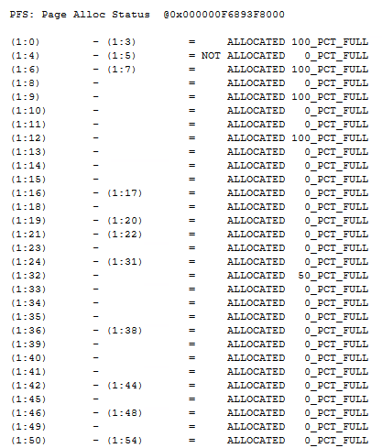
Page Free Space (PFS)
Page 1: PFS
Tracks free space available for each page
All operations need a latch on PFS page to know which page has space

Slide 13
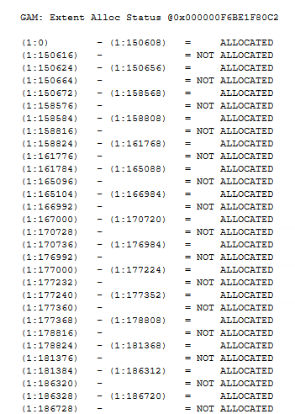
GAM (Global Allocation Map)
Page 2: GAM
Tracks if an uniform extent is allocated or not
1 extent = 8 pages
Uniform extent = all 8 pages belong to same object
All operations need a latch on GAM page to know which page is allocated or not

Slide 14
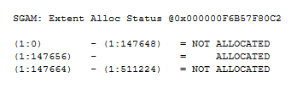
SGAM (Shared Global Allocation Map)
Page 3: SGAM
Tracks if a mixed extent is allocated or not
Mixed extent = 8 pages belong to different objects
All operations need a latch on SGAM page
to know which page is allocated or not

Slide 15

Multiple transactions hit on a datafile
PFS
Page 1
GAM
Page 2
SGAM
Page 3
data pages
PFS 2
Page 8088
data pages
GAM 2
Page 511232
SGAM 2
Page 511233
Tempdb.mdf
https://gohigh.substack.com/p/pfs-gam-sgam-pages

Slide 16
Identify Object Allocation Contention
PAGELATCH_UP, PAGELATCH_EX waits on PFS and (S)GAM pages
How to find them:
2:FileID:1 or 2:FileID:<any PFS or (S)GAM page>
Perfmon counters:
Access Methods::Worktables created/sec
Access Methods::Workfiles created/sec
Number > 200

Slide 17
Resolve Object allocation contention
Multiple Transactions
Transactions are spread across multiple datafiles
Allocation 1
Allocation 2
Allocation 3
Allocation 4
PFS
PFS
PFS
PFS
PFS
GAM
GAM
GAM
GAM
GAM
SGAM
SGAM
SGAM
SGAM
SGAM
data pages
data pages
data pages
data pages
data pages
Allocation 5
Allocation 6
Allocation 7
Allocation 8
PFS 2
PFS 2
PFS 2
PFS 2
PFS 2
data pages
data pages
data pages
data pages
data pages
GAM 2
GAM 2
GAM 2
GAM 2
GAM 2
SGAM 2
SGAM 2
SGAM 2
SGAM 2
SGAM 2
Tempdb.mdf
Tempdb.mdf
Tempdb_1.ndf
Tempdb_2.ndf
Tempdb_3.ndf

Slide 18
Resolve Object allocation contention
Round Robin
between datafiles
between PFS pages starting in SQL Server 2017 CU7
Create 1 data file per logical processor up to 8 logical processors
Additional files in numbers of 4
Create with same size and same autogrowth
Proportionally fills datafiles based on empty space

Slide 19
Resolve Object allocation contention – by SQL Server version
Prior to SQL 2016: Turn ON Trace flags 1117, 1118
SQL 2016 and onwards: Trace Flags are ON by default
SQL 2019: PFS page is updated with a shared latch instead of exclusive latch
SQL 2022: GAM and SGAM pages are updated with a shared latch
Follow best practices across all versions

Slide 20
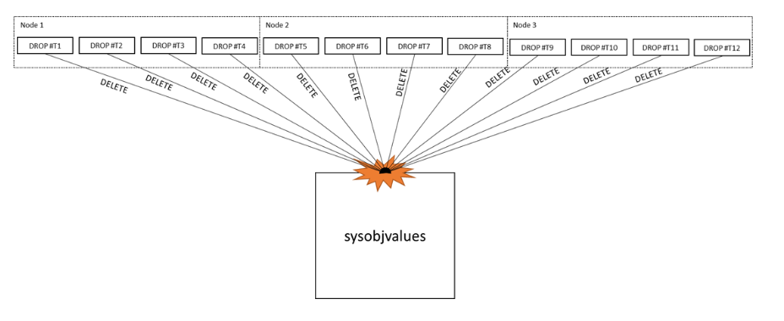
Metadata contention – DDL
In any database, when there are create, alter, drop operations on user objects, they need a latch on system object pages on a datafile.
In tempdb, multiple create, alter, drop sessions run concurrently on temporary objects, waiting for a latch on system object pages, causing contention
https://learn.microsoft.com/en-us/archive/blogs/sql_server_team/tempdb-files-and-trace-flags-and-updates-oh-my

Slide 21
Identify Metadata Contention
PAGELATCH_EX, PAGELATCH_UP waits on system catalog tables - such as sysobjvalues and sysschobjs
How to find them 2:FileID:<system page>
Perfmon counters:
SQLStatistics::PageLatch Wait
Temp Tables Creation Rate
Temp Tables Destruction Rate

Slide 22
Resolve Metadata contention
Don’t drop/truncate temp tables
Cache temporary objects:
Don’t alter temp table DDL statements after creation
Create temp objects within SP, trigger, function
Enable Memory-Optimized TempDB Metadata starting SQL 2019
CU2 moves sysallocunits

Slide 23
Temp table cache contention
Contention on cache for Temp table memory objects
Why?
Inefficient usage of Hash tables in cache

Slide 24
Identify/Resolve Temp table cache contention
CMEMTHREAD waits
SOS_CACHESTORE spinlock waits
Open a Microsoft case, needs advanced debugging

Slide 25
DEMO

Slide 26
Summary: Object Allocation Contention
Observe: PFS, GAM, SGAM pages
Wait Type: PAGELATCH_UP, PAGELATCH_SH
Resolution:
Multiple Datafiles
Upgrade to SQL Server Version 2022

Slide 27
Summary: Metadata Contention
Observe: System Object pages
Wait Type: PAGELATCH_EX, PAGELATCH_SH
Resolution:
Don’t drop Temp objects
CACHE Temp objects
Turn ON in-memory TempDB metadata feature in SQL Server Version 2019 and above

Slide 28

Summary: Temp Table Cache Contention
Observe: Huge memory objects in cache
Wait Type: CMEMTHREAD, SOS_CACHESTORE
Resolution:

Slide 29
Why learn about TempDB Contention
Troubleshoot Slowness
Concurrency Management

Slide 30
Resources
TempDB: The Good, The Bad, and The Ugly by Pam Lahoud
https://youtu.be/5jpfy19yl7k?si=vmgf3zqxokurpeo0
OStress utility: https://learn.microsoft.com/en-us/troubleshoot/sql/tools/replay-markup-language-utility
Klaus Aschenbrenner: https://www.sqlservercentral.com/blogs/improved-temp-table-caching-in-sql-server-2014
Pro SQL Server Internals book by Dmitri Korotkevitch

Slide 31
Reach Out For More Questions
Email: haripriya.naidu1@gmail.com
GitHub: https://github.com/haripriyasb/tempdb
Substack: https://gohigh.substack.com
LinkedIn: https://www.linkedin.com/in/haripriya-naidu1215

Slide 32
Thank You!

Slide 33
Tempdb spill
Query does not get granted enough memory to finish the operation and gets spilled over to TempDB to complete the operation
Why?
Bad cardinality estimations
Common spills: Hash Spill, Sort Spill, Exchange Spill

Slide 34
Summary
Types
Object Allocation
Metadata Contention
Temp Table Cache
Contention
Contention
Observe
PFS, GAM, SGAM
System Object pages
Memory Objects in
pages
Cache
Wait Type
PAGELATCH_UP,
PAGELATCH_UP,
CMEMTHREAD,
PAGELATCH_EX
PAGELATCH_EX
SOS_CACHESTORE
Resolution
Multiple Datafiles,
Don’t alter/drop
Open Case with
SQL Server Version
Temp Table, Cache,
Microsoft
Upgrade to 2022
Memory Optimized
feature 2019

Slide 35
Summary
Types | Object Allocation Contention | Metadata Contention | Temp Table Cache Contention
Observe | PFS, GAM, SGAM pages | System Object pages | Memory Objects in Cache
Wait Type | PAGELATCH_UP, PAGELATCH_EX | PAGELATCH_UP, PAGELATCH_EX | CMEMTHREAD, SOS_CACHESTORE
Resolution | Multiple Datafiles, SQL Server Version Upgrade to 2022 | Don’t alter/drop Temp Table, Cache, Memory Optimized feature | Open Case with Microsoft

Slide 36
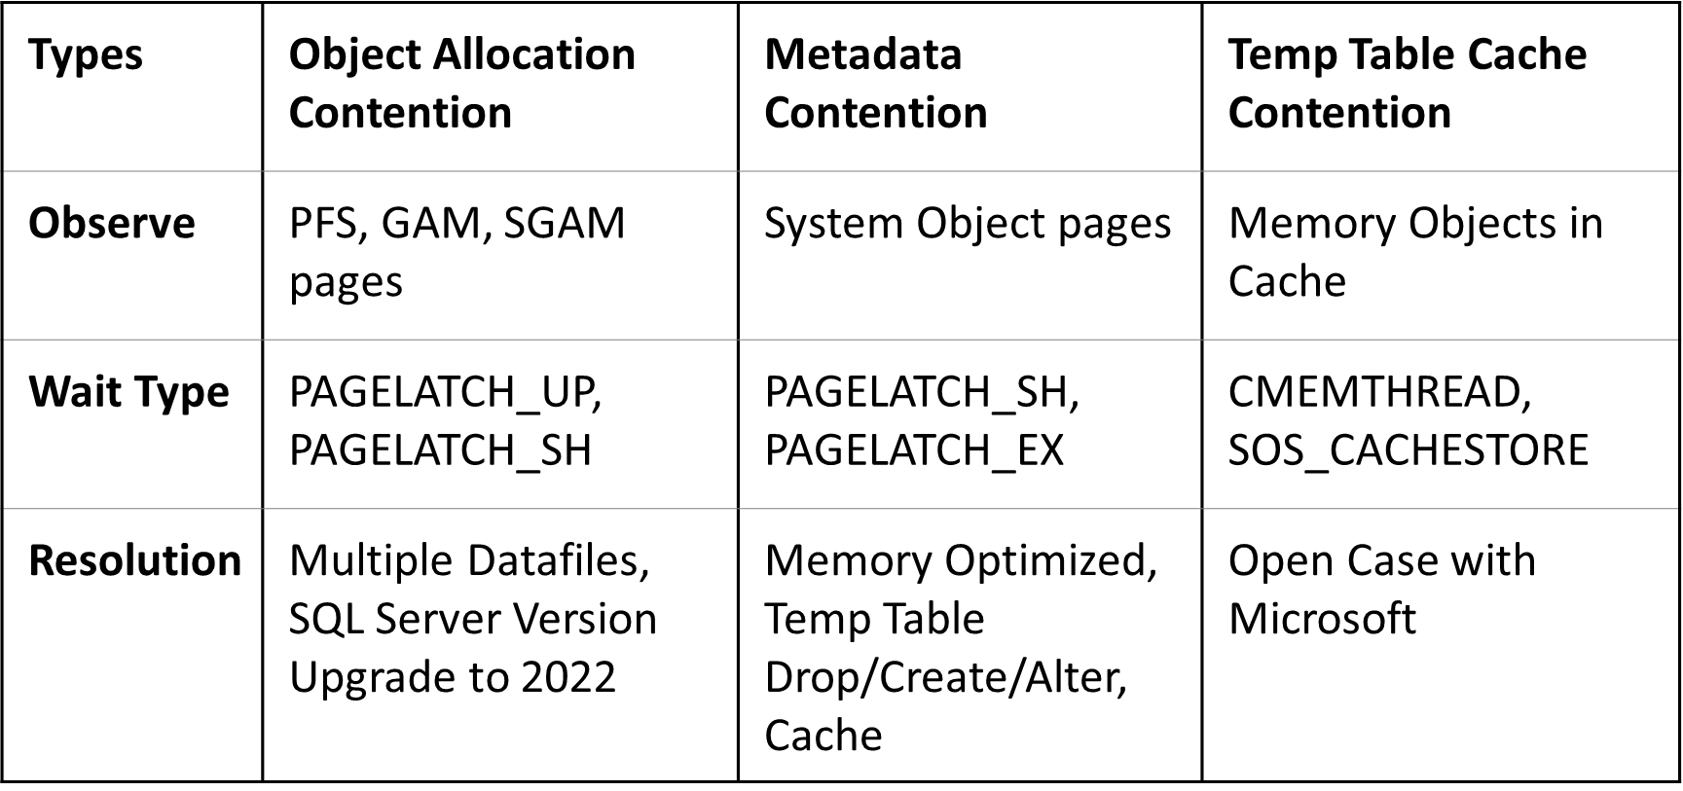
Summary

Slide 37
Object Allocation Contention - DML
Excessive allocation/deallocation on tracking pages due to insert, update, delete operations on temp tables
Tracking pages: Track status of data pages

Slide 38
Summary
Types | Object Allocation Contention | Metadata Contention | Temp Table Cache Contention
Observe | PFS, GAM, SGAM pages | System Object pages | Memory Objects in Cache
Wait Type | PAGELATCH_UP, PAGELATCH_SH | PAGELATCH_SH, PAGELATCH_EX | CMEMTHREAD, SOS_CACHESTORE
Resolution | Multiple Datafiles, SQL Server Version Upgrade to 2022 | Memory Optimized, Temp Table Drop/Create/Alter, Cache | Open Case with Microsoft

Slide 39
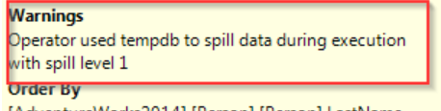
Identify Tempdb spill
Extended events: Hash warning, Sort warning, Exchange_spill
RESOURCE_SEMAPHORE waits
Execution plan warning: --pop out more

Slide 40
Resolve Tempdb spill
Up-to-date Statistics
Create covering indexes
Query Optimization:
Use temp tables instead of subqueries
Divide a huge query into multiple small queries
Re-write queries to avoid parameter sniffing
--table right datatypes

Slide 41
Causes of contention
High Transactional Workload
Inefficient Queries
TempDB Configuration Issues
Resource-intensive sorts, hash operations
Version Store Growth
Insufficient TempDB Files
Inadequate Memory for Query Execution

Slide 42
About me
SQL Database Administrator – 10 years
Focus on
SQL Server engine internals
Performance tuning
Server/DB Operations
Actively participate in
NESSQL
SQL Saturdays
Multiple online learning communities
Rookie of the Year 2023 @Work

Slide 43
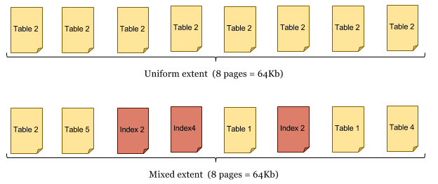
(S)GAM
GAM
Track allocation status of Uniform extents
bitmap 0 or 1 covering 4GB worth of extents
0= allocated
1=page is free, not allocated
Always 3rd page
SGAM
Track allocation status of Mixed extents
bitmap 0 or 1 covering 4GB worth of extents
0= page is free, not allocated
1= allocated
Always 4th page

Slide 44
How does contention form
Page Free Space (PFS)
Global Allocation Map (GAM)
Shared Global Allocation Map (SGAM)

Slide 45
Summary
Types of Contention – Object allocation, Metadata, Temptable cache
Identify – PFS, GAM, SGAM or system object pages and wait types
Resolve –
Datafiles
Cache
Query Optimization
Statistics
SQL Server version upgrade

Slide 46
Multiple Operations
Page 1: Page Free Space (PFS)
Page 2: Global Allocation Map (GAM)
D
Page 3: Shared Global Allocation Map (SGAM)
Datafile – tempdb.mdf

Slide 47
Page Free Space (PFS)
Tempdb.mdf
1 PFS page = 8KB = 8192 bytes
104 bytes are reserved
1 PFS page has 8088 bytes of
space in it
Needs 1 byte to track 1 page
8088 pages’ information
Page number | Page name
0 | File Header 8KB
1 | Page Free Space (PFS) 8KB
2
3
4
….. <multiple pages> 5-8087
8088 | Page Free Space (PFS) 8KB
….. <multiple pages> Next 8088 pages
16176 | Page Free Space (PFS) 8KB
….. <multiple pages> Next 8088 pages
8088 pages
8088 pages

Slide 48
GAM/SGAM
Tempdb.mdf
Page number | Page name
0 | File Header
1 | Page Free Space (PFS)
2 | Global Allocation Map (GAM)
3 | Shared Global Allocation Map (SGAM)
4
….. <multiple pages> 5-511231
511232 | Global Allocation Map (GAM)
511233 | Shared Global Allocation Map (SGAM)
….. <multiple pages> Next 511232 pages
1022464 | Global Allocation Map (GAM)
1022465 | Shared Global Allocation Map (SGAM)
….. <multiple pages> Next 511232 pages
GAM (Global Allocation Map)
Track allocation status of uniform extents
SGAM (Shared Global Allocation Map)
Tracks allocation status of mixed extents
1 extent = 8 pages
1 page = 8KB =8192 bytes
First 204 bytes are reserved
7988 bytes in a (S)GAM page
= 7988 * 8 bits
= 63,904 bits
Needs 1 bit to track 1 extent
= 63,904 extents
= 63,904 * 8 pages
= 511,232 pages

Slide 49
Datafile – tempdb.mdf
Page 0: File Header
Page 1: Page Free Space (PFS)
Page 2: Global Allocation Map (GAM)
Page 3: Shared Global Allocation Map (SGAM)
Page 4: Unused
Page 5: Unused
Page 6: Differential Change Map (DCM)
Page 7: Bulk Change Map (BCM)
Data pages
… <more data pages>
Tracking pages
Track the status of data pages
Used when SQL Server needs to allocate space
Notes:
You know every datafile has datapages in it, which we query and see the results in ssms
Apart from the regular datapages, there are also some special pages in every data file
I’d like to talk about 3 special pages in this case since that will help in understanding contention better
PFS, GAM, SGAM

Slide 50
Page Free Space (PFS)
Page 1: Page Free Space (PFS)
Tracks free space available for each page
All operations need a latch on PFS page to know which page has space

Slide 51
GAM
Page 2: Global Allocation Map (GAM)
GAM (Global Allocation Map)
Tracks if an extent is allocated or not
1 extent = 8 pages
Uniform extent = all 8 pages contain the data of same object
All operations need a latch on GAM page to know which page is allocated or not

Slide 52
SGAM
Page 3: Shared Global Allocation Map (SGAM)
SGAM (Shared Global Allocation Map)
Tracks if an extent is allocated or not
1 extent = 8 pages
Mixed extent = 8 pages contain the data of different objects
All operations need a latch on SGAM page
to know which page is allocated or not

Slide 53
Multiple Transactions
PFS
GAM
SGAM
Tempdb.mdf

Slide 54
Page Free Space (PFS)
Page 1: Page Free Space (PFS)
Tracks free space available for each page
All operations need a latch on PFS page to know which page has space

